Slide 1
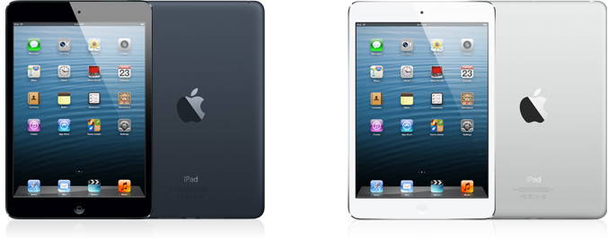


Apple’s iPad Mini
Created by: Anthony Hoang ITEC, 1301
Instructor: Natalia Fofanova
University of Houston
Be patient, sound is loading
Notes:
Header/footer.

Slide 2
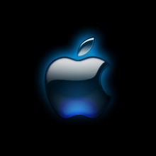
Table of Contents:
Apple’s iPad Mini
Who
Apple User
Why
Size Comparison
Kindle Versus iPad
What
Amazon Comparison
Credits 1
iPad Apps
Smaller iPad
When/Where
Credits 2
Bad Apple
Worth it?
Be patient, sound is loading
Notes:
Make sure hyperlinks work.

Slide 3
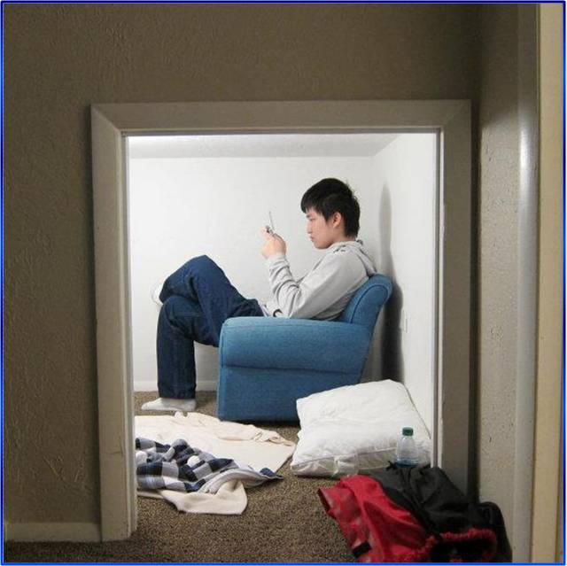

Apple User
My name is Anthony Hoang.
  I’m an Apple user.
I recently started using Apple products since a year ago. For me, it’s more than simply for its novelty and brand name. I can program and make applications for it.
  Insofar, I haven’t released any applications yet, but I would like to once I finish them. I’m still in the process of learning how to program efficiently and making fun, useful apps.

Slide 4




Who Uses the iPad Mini?
Anyone, like you or me!

Slide 5
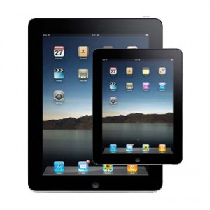
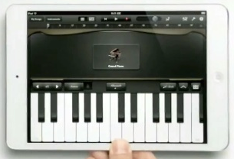
What is an Ipad Mini?
An iPad Mini is essentially a smaller version of an iPad.
  They both have the same functions.
An iPad is a device that attempts to combine the innovative features of an multi-touch interface with the functions of a computer.
Although the iPad mini is smaller than the original, the size does not affect its uses.
  Games are still playable on it with ease.

Slide 6

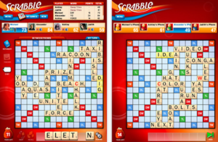
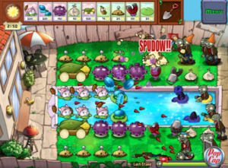
iPad Applications
There are various iPad applications to choose from in order to enhance your iPad mini experience such as…:
iBooks: Apple’s ebook store.
Scrabble: a board game for when you’re “bored.”
Plants versus Zombies: a tower defense game.

Slide 7

Where/When To Use An iPad Mini?
When you’re on a hiking trip.
When you’re on a road trip.
When you’re at home.
When you’re away from home.
When you’re lost and need a map.
When your friend is lost and needs a map.
When you’re drinking coffee at Starbucks.
You can use an iPad anywhere!

Slide 8
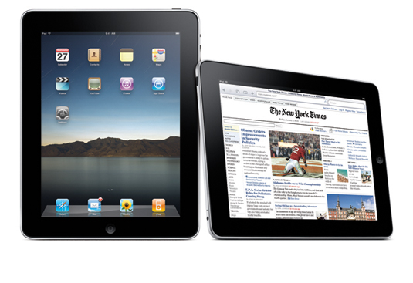
Why an iPad Mini?
Everything you can do on a laptop is conveniently placed inside a tiny iPad mini!
Browse the Internet:
  Go on Facebook.
  Skype.
  Watch Youtube videos.
Play games.
Read a book.
Read the news.

Slide 9
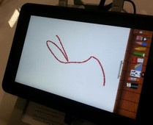
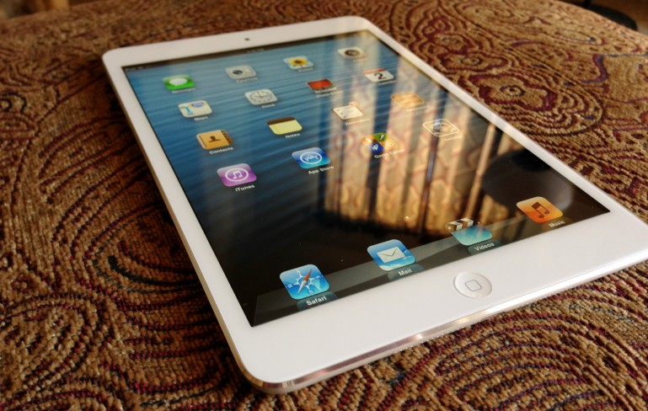
Kindle versus iPad
iPad mini has a bigger screen than the Kindle Fire, but weighs less.
iPad mini only has a 1024 x 768 pixel resolution screen whereas the Kindle Fire has a 1920 x 1200 pixel resolution.
The iPad mini costs much more than its competitors.
Kindle
iPad

Slide 10
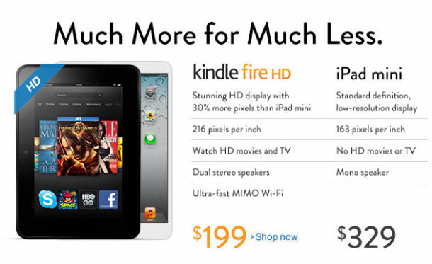
Amazon Comparison
This is a side by side comparison ad made by Amazon. The iPad mini does not look as favorable when compared side by side to the Kindle Fire.
Notes:
Amazon is not impressed with the iPad mini.

Slide 11

Bad Apple
Click to the video to play
Source: http://youtu.be/VzEUeWnV73U
The title of this song is “Bad Apple.”
  I placed this video here because the company “Apple” reminds me of this video.
Notes:
The music video is in Japanese, but it has subtitles.

Slide 12
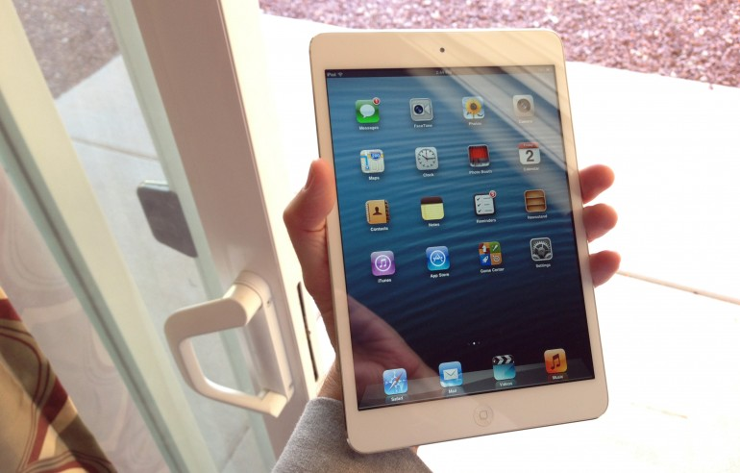
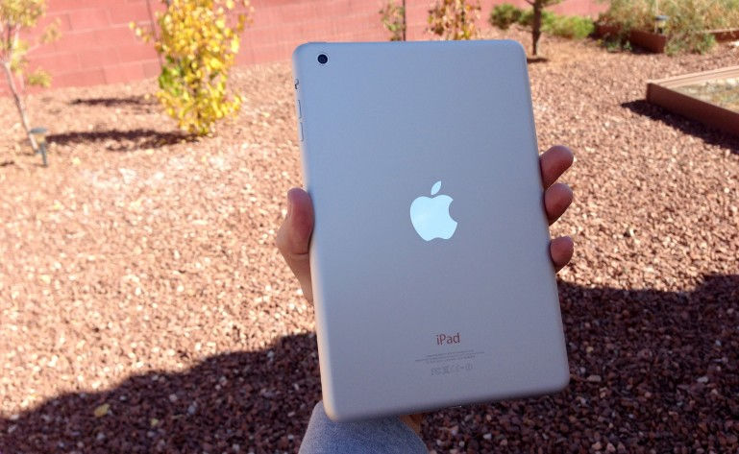
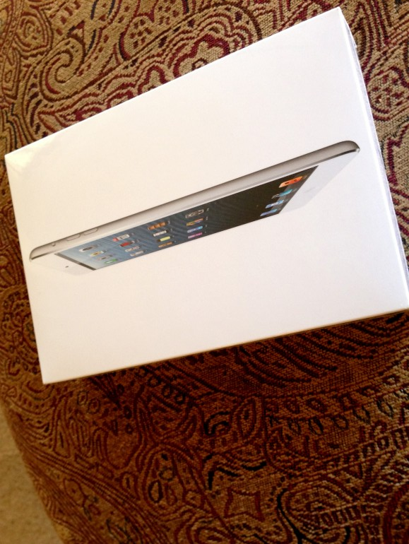
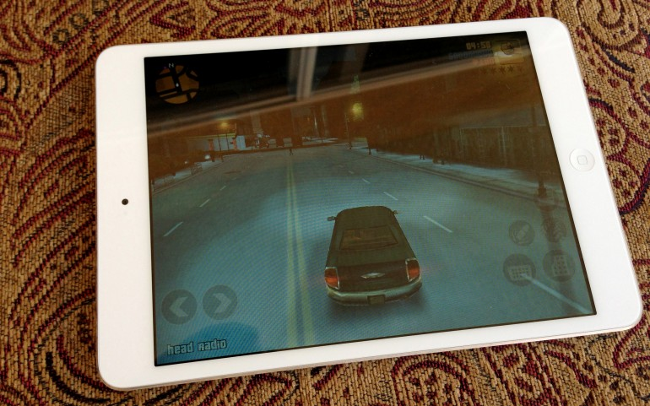
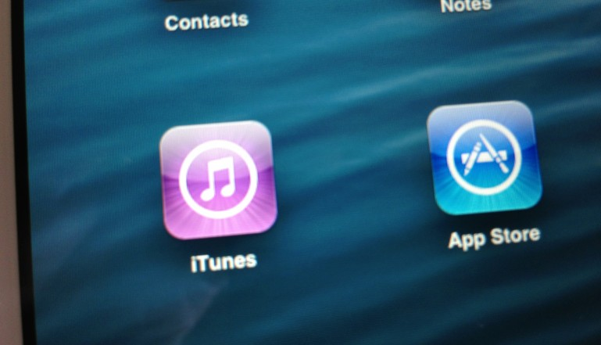
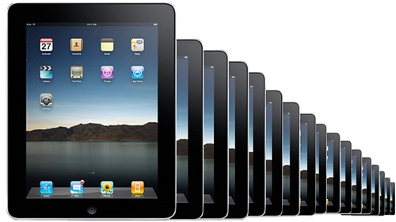
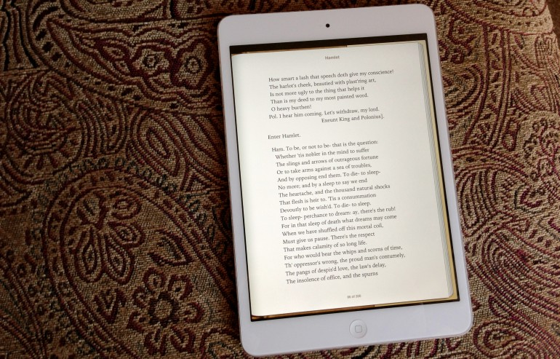
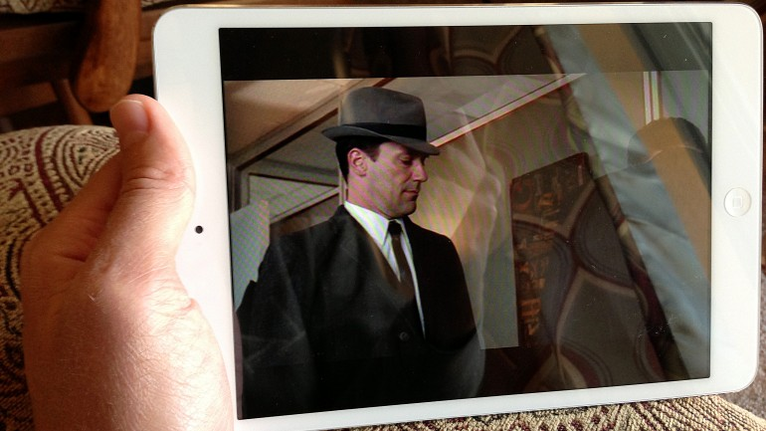
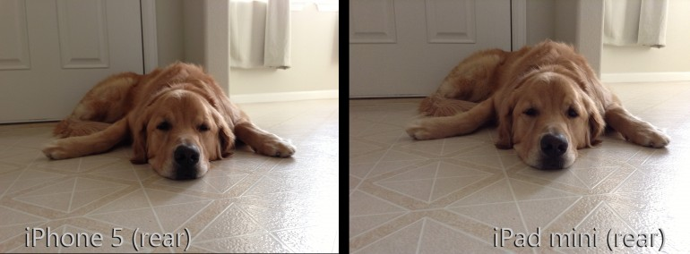
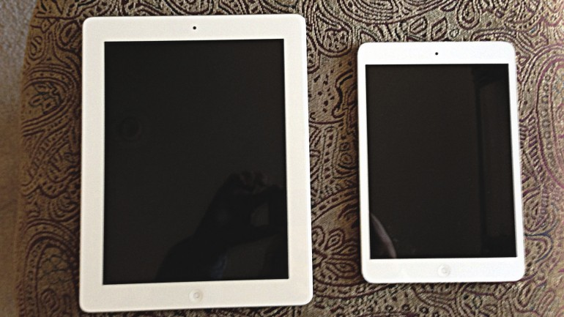
Ipad Mini
Just like an Ipad
But smaller!

Slide 13
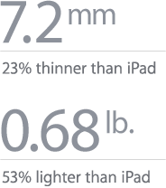

Slide 14
Credits 1
http://1.bp.blogspot.com/-wYbiIxIskhU/To3vE4Nei8I/AAAAAAAABLk/W99m0bkhF8Q/s1600/Apple_logo_Think_Different.png
http://stuffpoint.com/apple/image/92961-apple-apple-logo.png
http://media.beta.photobucket.com/user/ajsandiego/media/animated%20gifs/apple_back_md_wht.gif.html?filters[term]=apple%20gifs&filters[primary]=images&sort=1&o=56
http://images.apple.com/ipad-mini/specs/images/specs_color.jpg
http://images.apple.com/uk/ipad-mini/overview/images/hero.jpg
http://gadgetneed.blogspot.com/2012/10/why-ipad-mini-sucks.html
http://images.gizmag.com/inline/ipad-mini-review-12.jpg
http://www.gizmag.com/ipad-mini-review/24855/
http://www.authorstream.com/Presentation/Josephrobinson-1578375-why-buy-ipad-mini/
http://www.gizmag.com/ipad-mini-review/24855/pictures#1
http://www.gizmag.com/ipad-mini-review/24855/pictures#2
http://www.gizmag.com/ipad-mini-review/24855/pictures#5
http://www.gizmag.com/ipad-mini-review/24855/pictures#7
http://www.gizmag.com/ipad-mini-review/24855/pictures#8

Slide 15
Credits 2
http://www.gizmag.com/ipad-mini-review/24855/pictures#10
http://www.gizmag.com/ipad-mini-review/24855/pictures#11
http://www.gizmag.com/ipad-mini-review/24855/pictures#13
http://www.gizmag.com/ipad-mini-review/24855/pictures#17
http://www.zmescience.com/tech/five-unique-ways-ipad/
http://i.i.com.com/cnwk.1d/i/tim/2011/10/18/ipad-mini-300x300.jpg
http://youtu.be/VzEUeWnV73U
http://1.bp.blogspot.com/_o1S6k69_dgA/TIKJx6ClvZI/AAAAAAAAAAc/aC4Kb8QbuOc/s1600/Death_Note_L%5B7%5D.jpg
http://www.digitaltrends.com/wp-content/uploads/2012/11/ipad-mini-tv-ad.jpg
http://news.cnet.com/8301-1023_3-57541838-93/amazon-pits-kindle-fire-hd-vs-ipad-mini/
http://asset1.cbsistatic.com/cnwk.1d/i/tim/2012/10/28/Amazon_Kindle_Fire_vs_iPad_Mini_crop_01_610x373.jpg
http://www.examiner.com/article/kindle-fire-hd-8-9-goes-against-ipad-mini
http://www.dummies.com/how-to/content/what-is-an-ipad.html
http://gizmodo.com/5507569/gizmodos-essential-ipad-apps
http://www.torahslight.org/mountain.jpg

Slide 16
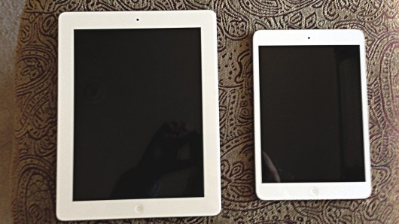

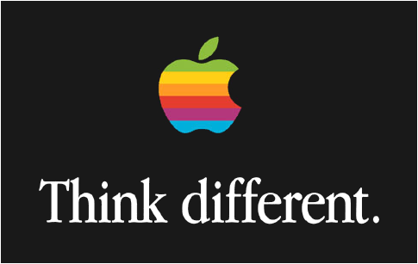
Is the Ipad Mini worth it?
You decide…!
Thank you!
Be patient, sound is loading

