Slide 1
SouthSides Reigna
Vaders Princess Lea “known to us as”…

Slide 2
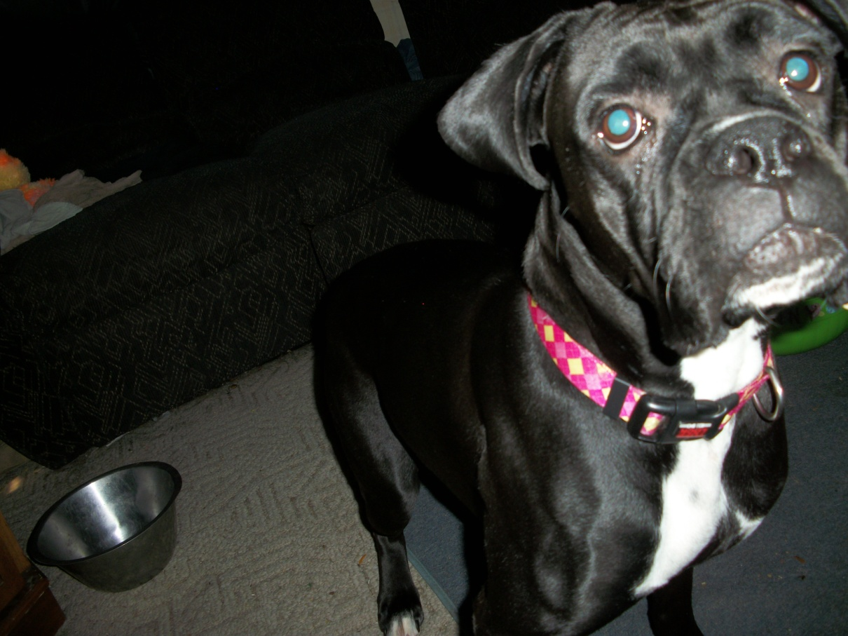
Reigna Posin
What are you doin Mom?

Slide 3
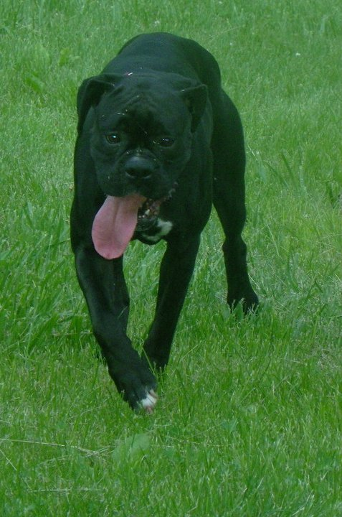
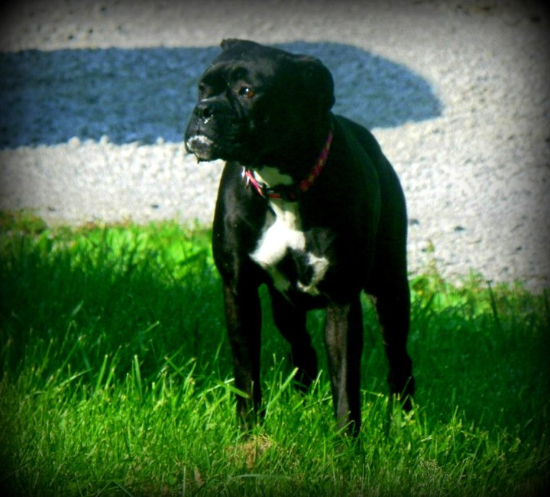
Photos’ by Sarah Dawn casper

Slide 4
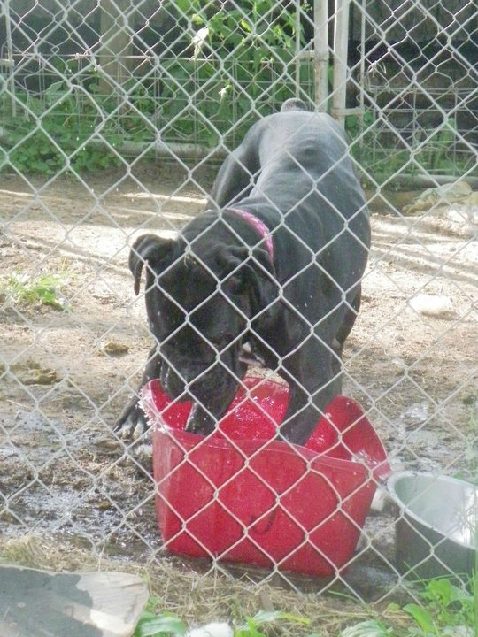

Photos’ by sarah dawn casper

Slide 5
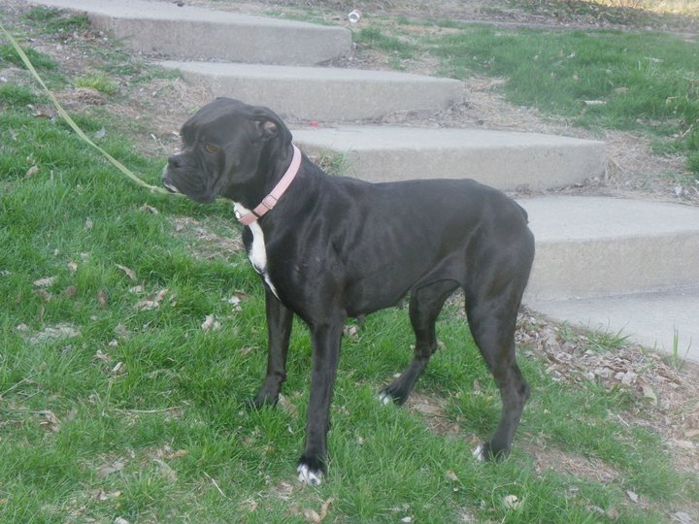
Beautiful Girl
Photo by Sarah Dawn Casper

Slide 6
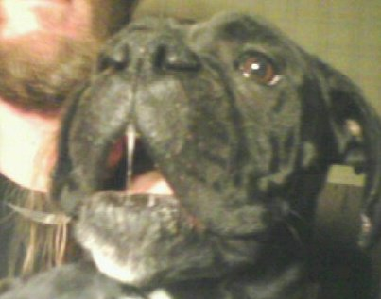
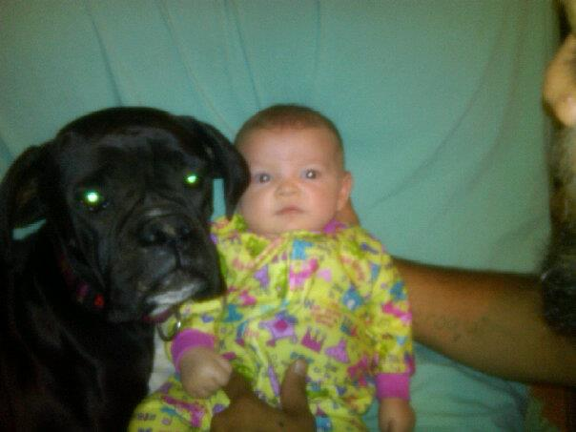
Funny Faces Lovin that baby

