Slide 1
Our newest addition
SouthSides Gracie May

Slide 2
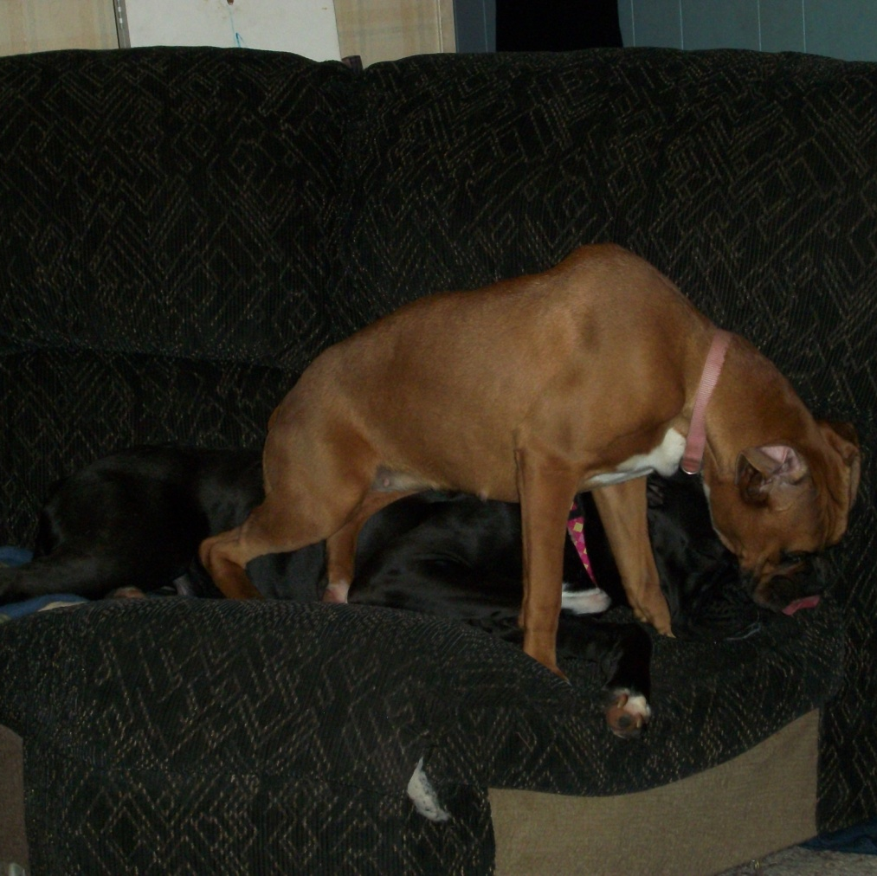
Gracie and reigna
Poor Reigna! Gracie thinks she has to sit on her all the time!

Slide 3
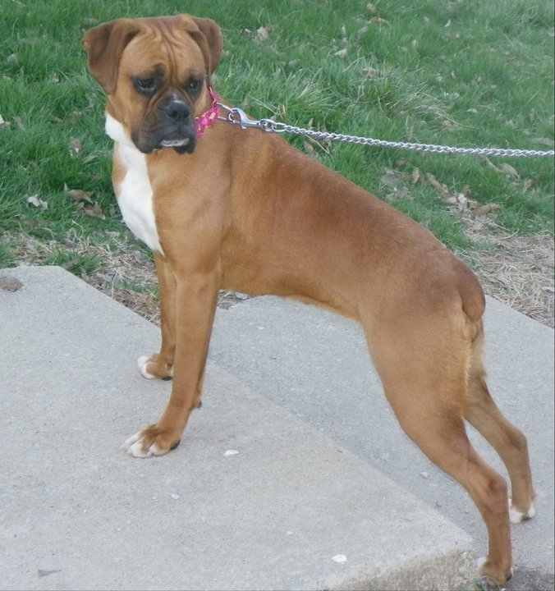
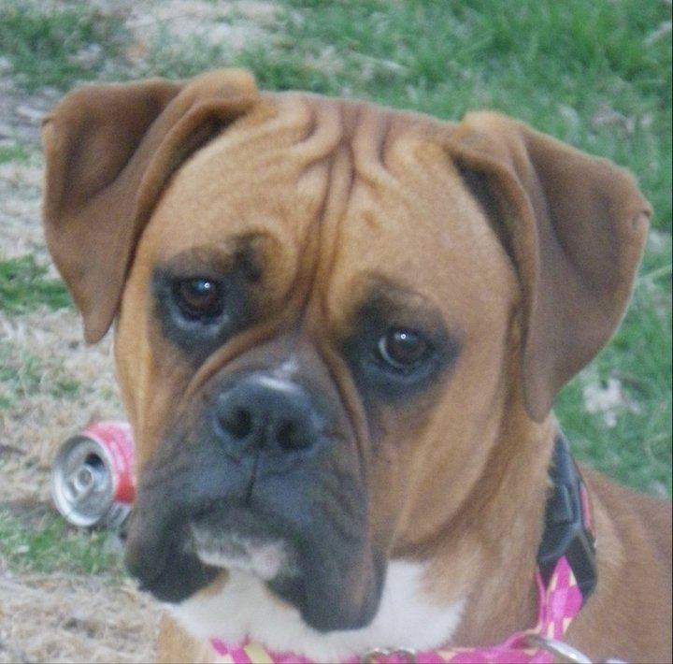
Photos’ by sarah dawn casper

Slide 4
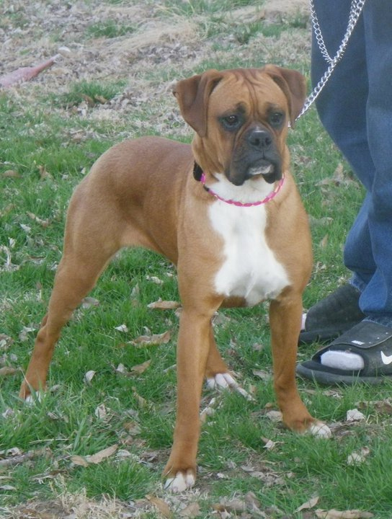
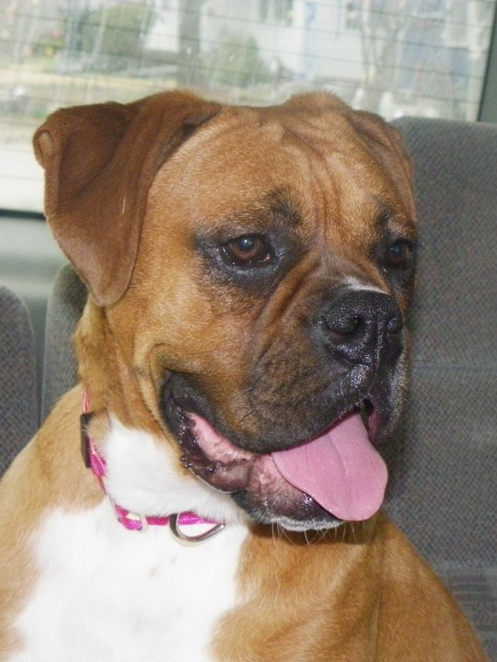
Photos’ by sarah dawn casper
Checking out her new home
Making herself at home in the van

Slide 5
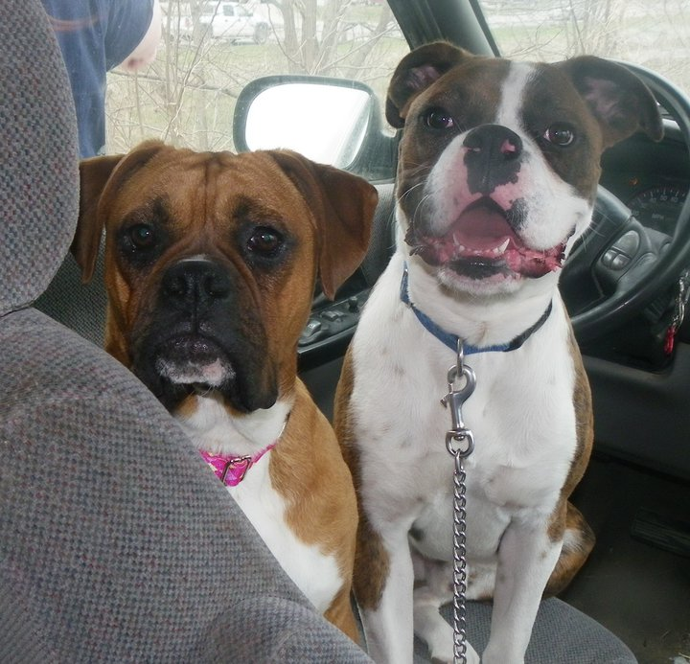
Ready to go home!
Cholo welcoming Gracie to the pack!~

